Slide 1
Oracle JSON Database Overview

Slide 2
Agenda
Oracle converged Database
JSON in the Database
Autonomous JSON Database
Why Oracle?
Benchmarks
Summary

Slide 3
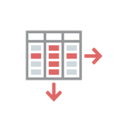

Data Strategy
Modern Applications require many different:
Data Types - Relational, Document, Spatial, Graph, etc.
Workloads - Transactions, analytics, ML, IoT, etc.
Each data type and workload requires different database algorithms
Two possible Data Strategies:
Use polyglot persistence with “single-purpose” database for each data type and workload
Use a converged database for all data types and workloads

Slide 4
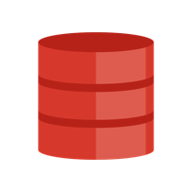


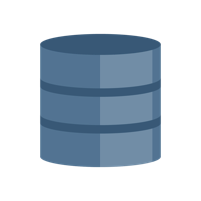
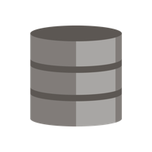
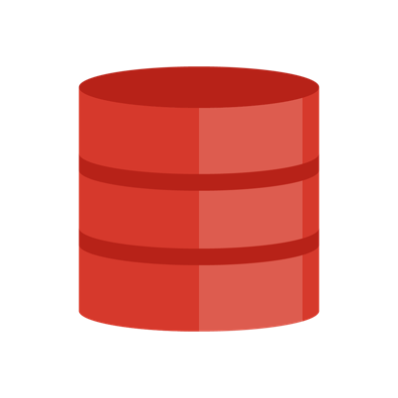
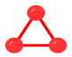



Data Strategy - Converged vs Polyglot
Oracle Database
Converged Architecture
Polyglot persistence
data pipelines to move out data for OLTP, analytics, search, …
Multiple databases to maintain, patch
Multiple datasets to backup, administer
Relational
OracleDB
mongoDB
ElasticSearch
JSON
TEXT
……..
NoSQL
Key Value
Graph
All your data managed together
Spatial
Files

Slide 5





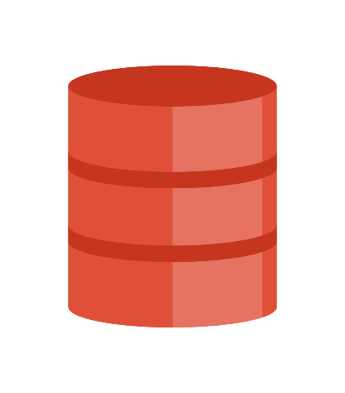
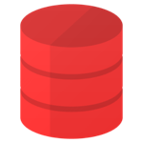

Polyglot persistence – Comes at a cost
Complexity in Integrating different databases
Administrative overheads for patching, security, backups
Fragmentation in APIs, Tools, Monitoring
HA, Scalability must be architected for each database
Pipelines to manage data consistency
EVENT
RPC
EVENT
RPC
EVENT
RPC
EVENT
RPC
ETL
REPLICATION
DB LINKS
ETL
REPLICATION
DB LINKS
ETL
REPLICATION
DB LINKS
ETL
REPLICATION
DB LINKS

Slide 6
Oracle Converged Database - Enables Simplicity and Data Synergy
Oracle Converged Database Supports all Workloads, Data Types
OLTP
Analytics
Microservices, IoT, Key-Value
ML, AI, R, Big Data
Relational
Documents
Graph, Spatial
Micro-Service IoT, Key-Value
Traditional
Next Generation
Structured and Unstructured

Slide 7
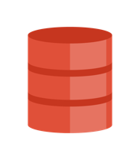
Oracle Converged Database - Flexible deployment options
Multimodel
ATP
TEXT
TEXT
Container Database
AJD
….
Specialized
On-prem
Cloud

Slide 8
Oracle Converged Database - Document Database
JSON
TEXT
XMLDB, …
<XML>
Native support for JSON storage, query and generation
Full SQL/PLSQL access
Collections API (SODA) with language drivers
Full featured Text engine
Premier text search quality
Advanced features (text management, doc services, NLP)
Best Internationalization support
Many more features including XMLDB, LOBs, ..
Full multimodel support including interoperability with relational, spatial
Consistent SQL/PLSQL access

Slide 9
JSON Customer: Financial
Financial instruments with many optional attributes (±1600)
Example: interpolated price for a rarely traded asset
Not every asset has all 1600 attributes, on average 100-200
Attributes are stored as JSON
Schema-free, only relevant attributes stored - no NULL values
attributes can be added without database changes or downtime
Purely driven by application
Reporting done using existing relational processing
JSON flattened to table (JSON_TABLE)
View for each consumer
Views can be dynamically added/modified

Slide 10
JSON Customer: Insurance
Insurance policies are JSON documents
Relatively large and nested JSON structure
Various policy types and formats, format evolution
JSON policies inserted and fetched as one record
No decomposition (normalization) into many tables.
No reconstruction from tables (joins)
-> low latency puts and gets as
Reporting (statistics, risks, etc)
Existing relational processing
Initially planned to use MongoDB
Now using Oracle with JSON_TABLE materialized views

Slide 11
JSON Customer: Electronics manufacturer with retail stores
Point of sales application
Entire data model is JSON for new developments
Document database model (similar to MongoDB)
Company makes extensive use of noSQL products
Customer chose Oracle JSON + SODA APi
Transactions (financial data, order status)
JSON generation -> Reporting as JSON
Joins
Stored procedures
many more enterprise features of the Oracle ecosystem …

Slide 12














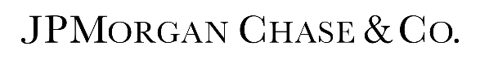






JSON Customers: Analysis of S/Rs as of March 15th 2018
Oracle Confidential - Internal Use Only
MARKET SEGMENT | Customers
Analytical Services | 5
Automotive | 4
Engineering | 1
Financial Services | 25
Government | 21
Health Care | 9
Higher Education & Research | 13
Insurance | 5
Manufacturing | 8
Marketing | 7
Pharma | 2
Publishing | 3
Retail | 10
Technology | 16
Telco | 18
Travel & Entertainment | 10
Utilities | 5

Slide 13
Agenda
Oracle converged Database
JSON in the Database
Autonomous JSON Database
Why Oracle?
Benchmarks
Summary

Slide 14
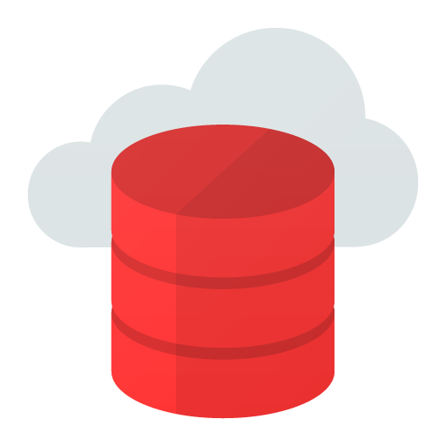




Oracle JSON Document Database
Oracle Database
SODA (JSON)
SQL
No-SQL Application development using SODA
JSON Documents
Stored and Managed
Using Oracle Database
SQL based reporting
and analytical operations
on JSON Documents
Notes:
Now we're going to talk about the conceptual JSON document store. You can build this now in Oracle database 18c or later, either in the cloud or on-prem.
We start with JSON documents in the database, stored as we've said in BLOB column
Our application need know nothing about SQL and talks to the database using the SODA – Simple Oracle Document Architecture – API.
SODA offers a simple way to manipulate JSON documents organized into collections. It can do CRUD operations – Create, Read, Update, Delete and it can do querying using the Query By Example or QBE model where you provide a fragment or fragments of a JSON document, and it gives you back all the documents in a collection that match that fragment.
On the right we have our management tools written in SQL. We have all the power of SQL and Oracle analytic functions available to us to query and process the JSON in the database.
SODA (Simple Oracle Document Access)
Abstract API that enables NoSQL Style Application Development
SODA Features
JSON documents organized as collections
Create and drop collection operations, index collections
CRUD (Create, Retrieve, Update and Delete) operations on documents
Query by Example
Bulk Insert
No need for SQL or an Oracle DBA to develop or deploy applications
Current SODA implementations for REST and Java – others planned

Slide 15
Native JSON - Integrated with the breadth of the Oracle Database
JSON Binary Type
New datatype in SQL, PLSQL
Natively supported in OCI, JDBC
Based on OSON - Optimized Binary representation
Self-contained format
Fast field lookups
Piecewise Updatable
Scans up to 10x faster than text
Updates up to 10x faster than text
Natively supported in the database
Integrated with the breadth of the Oracle Database platform
Parallel Query
RAC
Golden Gate
…
Leverage Advanced Security features
VPD, Encryption, ..
Manage JSON together with other data
Operational simplicity from converged database
CREATE TABLE J_PURCHASEORDER (
id INTEGER PRIMARY KEY,
po_document JSON
);
Notes:
In versions up to and including 19c we stored JSON is any text column. You can choose VARCHAR2, CLOB or BLOB for storage.
We can force JSON parse checks by using the IS JSON constraint.
We can also leave the storage of the JSON outside the database itself by using the external tables mechanism.
In 20c we are introducing a new binary JSON type.
This has a number of advantages – it's essentially self-indexed so it's much faster to get to a particular key-value pair. This is very important for non-indexed scans.
It's also much easier to piece-wise updates – rather than parsing the whole document, creating a DOM model, updating that and then creating a new document, we can jump directly to the part we want and do the necessary update steps there. Not much of a difference for very short documents but a huge gain for very large documents.

Slide 16
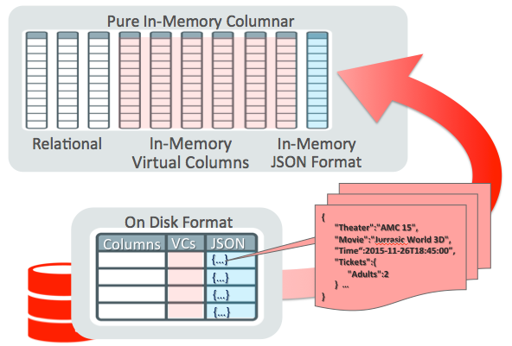


Native JSON – Advanced Optimizations
Parallel Query
Materialized View
ExaData (DB Machine)
Storage Cell Node Smart Scan
JSON Path Evaluation in Storage Node
In Memory Columnar Store
SIMD Scan for JSON_VALUE()
Path/Value InMemory Index
for JSON_EXISTS() &
JSON_TEXTCONTAINS() Predicates

Slide 17
OSON – Oracle’s optimized Binary JSON
SELF-CONTAINED
Field encoding dictionary is stored inside each OSON document
No central schema management and evolution Issues
Fully transportable, distributable, platform Independent without any conversion
FAST FIELD LOOK UP with a field jump table for rapid SQL/JSON path navigation
Tree based encoding gives constant-time access to field values given field name
Leaf Scalar datatypes (numbers, dates etc) uses the same format as relational scalar
Avoid data format conversions and enables fast memcomp based range comparisons
PARTIAL UPDATABLE
InPlace Update if length fits, otherwise append bytes in the end with forward address
Avoid Whole Document Replacement as much as possible

Slide 18
OSON - Logical-Segment Architecture
1: po 2:id
3: podate 4:items
….
Field-Id-Name Dictionary Segment
Ref Field ID
offset
1:2014-09-08
Phone
100
Ipad
….
Leaf-Value-Segment
Tree Navigation Segment with Field Jump Table

Slide 19
OSON – upto 2.7x more compact than BSON

Slide 20
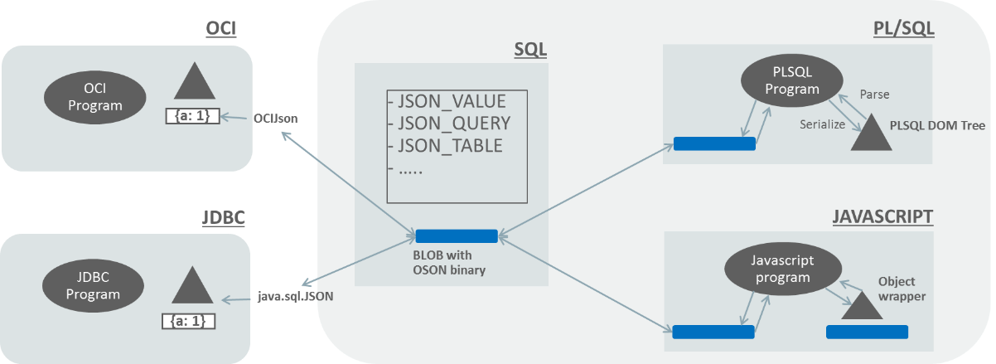
OSON – End to end support without conversions

Slide 21
Oracle JSON Document Database
Oracle Database
SODA (JSON)
SQL
No-SQL Application development using SODA
JSON Documents
Stored and Managed
Using Oracle Database
SQL based reporting
and analytical operations
on JSON Documents
Notes:
Now we're going to talk about the conceptual JSON document store. You can build this now in Oracle database 18c or later, either in the cloud or on-prem.
We start with JSON documents in the database, stored as we've said in BLOB column
Our application need know nothing about SQL and talks to the database using the SODA – Simple Oracle Document Architecture – API.
SODA offers a simple way to manipulate JSON documents organized into collections. It can do CRUD operations – Create, Read, Update, Delete and it can do querying using the Query By Example or QBE model where you provide a fragment or fragments of a JSON document, and it gives you back all the documents in a collection that match that fragment.
On the right we have our management tools written in SQL. We have all the power of SQL and Oracle analytic functions available to us to query and process the JSON in the database.
SODA (Simple Oracle Document Access)
Abstract API that enables NoSQL Style Application Development
SODA Features
JSON documents organized as collections
Create and drop collection operations, index collections
CRUD (Create, Retrieve, Update and Delete) operations on documents
Query by Example
Bulk Insert
No need for SQL or an Oracle DBA to develop or deploy applications
Current SODA implementations for REST and Java – others planned

Slide 22
SQL/JSON
SQL/JSON standard
Joint proposal with IBM
SQL extended with new operators for json e.g. JSON_VALUE
All operators use JSON Path language for intra document navigation
CREATE TABLE J_PURCHASEORDER (
id INTEGER PRIMARY KEY,
po_document JSON);
SQL> select JSON_VALUE(PO_DOCUMENT, ‘$.LineItems[0].Part.UnitPrice’
2 returning NUMBER(5,3))
3 from J_PURCHASEORDER p
4 where JSON_VALUE(PO_DOCUMENT, ‘$.PONumber’
5 returning NUMBER(10)) = 1600
Notes:
Then there are the standard SQL/JSON operators developed with other vendors.
It's somewhat more long-winded than the simplified syntax, but it's flexible and portable.

Slide 23
JSON Query – SQL/JSON
SELECT
JSON_QUERY()
JSON_VALUE()
Extract values, fragments
FROM
Json Column
JSON_TABLE()
Relational Projection
Lateral Join
WHERE
JSON_EXISTS()
JSON_VALUE()
Predicates based on JSON
GROUP BY
JSON_VALUE()
Group by a JSON value
ORDER BY
JSON_VALUE()
Order by a JSON value
Notes:
Here's some example operators, and places in SQL where you can use them.
JSON_QUERY returns JSON, whereas JSON_VALUE returns a single scalar value.
JSON_EXISTS is a boolean function used to check for the existence of a particular condition.

Slide 24
JSON Query – Oracle Simplified Syntax
Oracle supports a non-standard simplified syntax
SQL> select j.PO_DOCUMENT
2 from J_PURCHASEORDER j
3 where j.PO_DOCUMENT.PONumber.number() = 1600
4 /
SQL> select j.*
2 from CUSTOMER c, 3 JSON_TABLE (c.jcol.orders.lineitems[*]
4 COLUMNS (lineid, quantity, prodid, upc, comments)) j
5 /
SQL> select JSON {cid, firstname, lastname, street, country, zip}
2 from CUSTOMERS
Field Access
Collection unnesting
JSON Generation
Notes:
Here's a some methods of accessing JSON from SQL. For documents which don't have a complex schema, we can use the dot notation, which is similar to the usual schema.table.column method, but extended a further level so we can access the json field directly.
JSON_TABLE is a table function which allows for unnesting arrays into a standard SQL table format. Not shown here but you have full control over datatypes and lengths of the "columns" within the table.
And finally we have a very simple way to create a JSON document from a SQL table.

Slide 25
JSON Update
New in 21c
JSON_TRANSFORM
Partial JSON Update support
Declaratively perform complex transformations on JSON
UPDATE emp_table
SET emp_doc = JSON_TRANSFORM( emp_doc,
SET '$.address.city' = 'Santa Cruz', SET '$.job’ = 'Surfer', SET '$.salary' = PATH '$.salary / 10',
REMOVE '$.phones[*]?(@.type == "office")' )
where id = :bv;
Notes:
JSON_TRANSFORM allows us to do complex updates to a JSON object without having to extract the whole document, parse it and update it and write it back.

Slide 26
JSON Generation - Embedding arrays in documents
select JSON_OBJECT(*)
from EMP;
DEPT_WITH_EMPLOYEES
--------------------------------------------------------------------------------
{
"departmentId": 90,
"name": "Executive",
"employees": [
{
"employeeId": 100,
"firstName": "Steven",
"lastName": "King",
"emailAddress": "SKING"
}, {
"employeeId": 101,
"firstName": "Neena",
"lastName": "Kochhar",
"emailAddress": "NKOCHHAR"
}, {
"employeeId": 102,
"firstName": "Lex",
"lastName": "De Haan",
"emailAddress": "LDEHAAN"
}
]
}
select JSON_OBJECT(
'departmentId' is d.DEPARTMENT_ID,
'name' is d. DEPARTMENT_NAME,
'employees' is (
select JSON_ARRAYAGG(
JSON_OBJECT(
'employeeId' is EMPLOYEE_ID,
'firstName' is FIRST_NAME,
'lastName' is LAST_NAME,
'emailAddress' is EMAIL
)
)
from HR.EMPLOYEES e
where e.DEPARTMENT_ID = d.DEPARTMENT_ID
)
) DEPT_WITH_EMPLOYEES
from HR.DEPARTMENTS d
where DEPARTMENT_NAME = 'Executive'
/
Notes:
Create a JSON document with nested arrays using JSON_ARRAYAGG
Here we're creating a JSON array from the EMPLOYEES table, then taking other non-array fields from the DEPARTMENT table.

Slide 27
JSON Index
CREATE UNIQUE INDEX po_ponum_index
ON j_purchaseorder po
(po.po_document.PONumber);
Functional Index
Index specific fields within a JSON document
Search Index
Universal Index for all fields
Supports value, range and full text
GeoSpatial Index
JSON_VALUE returns GeoJSON as SDO_GEOMETRY object
CREATE SEARCH INDEX po_search_index
ON j_purchaseorder (po_document)
FOR JSON
Notes:
Three types of JSON index.
Functional index where you know a field exists in the document and it needs to be indexed
Search index has two use cases
1/ You don't know the schema of your documents and just want everything indexed
2/ You want full-text searching on certain JSON values in the document
GeoSpatial index supports fast spatial searches

Slide 28
JSON Indexing & Materialized View
Schema-Aware JSON Indexing/MV Strategy
Single-Value Functional Index
Single-Value Spatial Functional Index
Multi-Value Functional Index (coming in 21c)
JSON_TABLE() Materialized View
Schema-Agnostic Indexing Strategy
JSON Search Index
Universal Inverted Index for full text search, scalar data range search
Indexing Schema & Data Together
Incrementally maintaining dataguide

Slide 29
JSON Functional Index
B+ tree based Single-Value Functional Index
Create index Idx1 on jtab( JSON_VALUE(jcol, ‘$person.address.zip’ returning NUMBER ) );
create index Idx2 on jtab jt (jt.j.person.birthdate.date()); -- using simplified syntax
create index Idx3 jtab(json_value(j,'$.person.id' returning number error on error))
B+ tree based Multi- Value Functional Index (New in 21C)
Create multi-value index funcIdx1 on jtab(jt1.person.creditscores[*].number())
R+ tree based Spatial Functional Index
CREATE INDEX json_documents_geo_idx ON json_documents (
JSON_VALUE(data, '$.features[0].geometry‘ RETURNING SDO_GEOMETRY))
INDEXTYPE IS MDSYS.SPATIAL_INDEX;

Slide 30
JSON_TABLE Materialized View
Statement level or Transaction level Refreshable
CREATE MATERIALIZED VIEW json_documents_mv
BUILD IMMEDIATE
REFRESH FAST
ON (STATEMENT|TRANSACTION) WITH PRIMARY KEY
AS
SELECT jtab.id, jt.*
FROM json_documents jtab,
JSON_TABLE(data, '$'
COLUMNS (FirstName, LastName, Job, Active,
NESTED ContactDetails COLUMNS (Email, Phone)
)
) jt
JSON DataGuide can generate JSON_TABLE() MV

Slide 31
JSON Search Index for Elastic/NoSQL UseCase
create search index THEATER_SEARCH on THEATER (THEATER_DOC) for JSON
Index everything, Elastic Search Capability Over JSON collection
Supports range searches on numeric, timestamp values
Supports path context aware full text searches
Builds on top of Oracle Text Inverted Index with LSM & Map/Reduce indexing maintenance
select count(*) from THEATER
where json_textcontains(THEATER_DOC,'$.address.streets', ‘BroadWay & Apart' ) and JSON_EXISTS(THEATER_DOC, ‘$.address.zipcode?(@ <95000 && @ > 94000)’)

Slide 32
Horizontal Scalability –Sharding NoSQL
Horizontal Scalability
Scale reads with replication
Scale writes with sharding
Oracle JSON Database Replication
JSON integrated with
Golden Gate,
Active Data Guard
JSON & Sharding Integration
Oracle DB sharding
JSON Tables and Indexes integrated with sharding
DDLs, Single shard queries
pushed down to shard
Cross shard queries
Pushed down to shard
Combine results from multiple shards

Slide 33
Sharding Support for JSON & Its Search Index
ALTER SESSION ENABLE SHARD DDL;
CREATE SHARDED TABLE gkd_data
(
id NUMBER NOT NULL,
docdate DATE,
doc JSON
),
PARTITION BY RANGE (”docdate") -- range partition
(PARTITION ”sys_zero” VALUES LESS THAN
(TO_DATE(' 1941-11-30 00:00:00', 'SYYYY-MM-DD HH24:MI:SS’,
'NLS_CALENDAR=GREGORIAN')) TABLESPACE ts1,
PARTITION "SYS_pone" VALUES LESS THAN
(TO_DATE(' 2001-11-30 00:00:00', 'SYYYY-MM-DD HH24:MI:SS’,
'NLS_CALENDAR=GREGORIAN')) TABLESPACE ts2;
CREATE SEARCH INDEX oidx ON gkd_data(doc) FOR JSON LOCAL;

Slide 34
Cross-Shard JSON Search Push Down
SELECT count(*)
FROM gkd_data
WHERE JSON_TEXTCONTAINS(doc,'$.gkg.locations.location', 'Dublin’)
-----------------------------------------------
| Id | Operation | Name |
-----------------------------------------------
| 0 | SELECT STATEMENT | |
| 1 | SORT AGGREGATE | |
| 2 | VIEW | VW_SHARD_0A7B4793 |
| 3 | SHARD ITERATOR | |
| 4 | REMOTE | |
-----------------------------------------------
Remote SQL Information (identified by operation id):
----------------------------------------------------
4 - EXPLAIN PLAN INTO PLAN_TABLE@! FOR SELECT COUNT(*) FROM
"GKD_DATA" "A1" WHERE JSON_TEXTCONTAINS("A1"."DOC",'$.gkg.locations.location','Dublin‘)
/* coord_sql_id=2pfvj8ms9w6uu */ (accessing
'ORA_SHARD_POOL.REGRESS.RDBMS.DEV.US.ORACLE.COM@ORA_MULTI_TARGET' )

Slide 35
JSON Dataguide - Schema Discovery
Discover metadata for JSON
Generate JSON Schema or
Generate relational schema
Derived relational views
Declarative procedures to construct a relational view over a JSON fragment
Derived virtual columns
Generated for singleton JSON keys
Automatically generated for new keys
Can be used with external data
SQL> select dbms_json.getDataGuide('MOVIE_TICKETS',
2 'BOOKING_DETAILS',
3 dbms_json.JSON_SCHEMA,
4 dbms_json.PRETTY)
5 from dual
"{
"type" : "object",
"properties" : {
"Movie" : {
"type" : "string", "o:length" : 16,
"o:preferred_vc_name" : "BOOKING_DETAILS$Movie"},
"Theater" : {
"type" : "string", "o:length" : 16,
"o:preferred_vc_name" : "BOOKING_DETAILS$Theater"},
"Tickets" : {
"type" : "object“, "o:length" : 16,
"o:preferred_vc_name" : "BOOKING_DETAILS$Tickets",
"properties" : {
"Adults" : { …... }}},
"StartTime" : {
"type" : "string", "o:length" : 32,
"o:preferred_vc_name" : "BOOKING_DETAILS$StartTime"}}
}"
Notes:
JSON dataguide discovers and reports the schema of your JSON documents, including datatypes and maximum lengths.
It also gives you procedures to create relational views over JSON content.
Dataguide can be created for an individual JSON document, or for a whole collection as part of a SEARCH index.

Slide 36
Oracle JSON Document Database
Oracle Database
SODA (JSON)
SQL
No-SQL Application development using SODA
JSON Documents
Stored and Managed
Using Oracle Database
SQL based reporting
and analytical operations
on JSON Documents
Notes:
Now we're going to talk about the conceptual JSON document store. You can build this now in Oracle database 18c or later, either in the cloud or on-prem.
We start with JSON documents in the database, stored as we've said in BLOB column
Our application need know nothing about SQL and talks to the database using the SODA – Simple Oracle Document Architecture – API.
SODA offers a simple way to manipulate JSON documents organized into collections. It can do CRUD operations – Create, Read, Update, Delete and it can do querying using the Query By Example or QBE model where you provide a fragment or fragments of a JSON document, and it gives you back all the documents in a collection that match that fragment.
On the right we have our management tools written in SQL. We have all the power of SQL and Oracle analytic functions available to us to query and process the JSON in the database.
SODA (Simple Oracle Document Access)
Abstract API that enables NoSQL Style Application Development
SODA Features
JSON documents organized as collections
Create and drop collection operations, index collections
CRUD (Create, Retrieve, Update and Delete) operations on documents
Query by Example
Bulk Insert
No need for SQL or an Oracle DBA to develop or deploy applications
Current SODA implementations for REST and Java – others planned

Slide 37
SODA – Document Store API
SODA document - analogous to rows in relational model
Each document has a unique key
SODA collection - analogous to tables in relational model
Collections reside in a database - analogous to schema in relational model
CRUD (create, remove, update, delete) operations on document collections
Basic operation driven by unique keys
Advanced operations driven by QBEs (Query-by-Example)
ID | CONTENT | VERSION | CREATED_ON | LAST_MODIFIED
3C990A8D39… | {“name” : “Alex”} | 75611B292… | 2018-09-12T00:00:00Z | 2018-09-12T00:00:00Z

Slide 38
SODA Java - CRUD
Create Collection
Create Document
Put Document
Get Document (by key)
Get Document (QBE)
OracleRDBMSClient client = new OracleRDBMSClient(); OracleDatabase db = client.getDatabase(conn);
OracleCollection collection = db.getDatabaseAdmin().createCollection(“Theaters”);
OracleDocument document = collection.find().key(“12..”).getOne();
OracleDocument filterSpec = db.createDocumentFromString("{\"name\":\“Orinda Theater\"}");
OracleCursor c=collection.find().filter(filterSpec).getCursor();
while(c.hasNext()) OracleDocument doc=c.next();
OracleDocument document = db.createDocumentFromString("{ \”id\" : “12..”, \”name\”: \”Orinda Theater\”, ….}”);
collection.insert(document);
Notes:
Here's some examples of using SODA through a dedicated API – in this case Java. Once we've defined our database connection db we can use that to create a new collection THEATRES.
Then we can create a document using any arbitrary JSON content – we're not constrained to any particular schema. That document is then added to the collection.
We can then fetch a document by key (top right) or by QBE – where the query returns us a cursor to iterate over the result set.

Slide 39
SODA - Drivers for Java, node.js, Python, OCI, PLSQL
Java
OracleClient cl = new OracleRDBMSClient();
OracleDatabase db = cl.getDatabase(jdbcConnection);
OracleCollection coll = db.admin().createCollection(“sweets");
coll.admin().drop();
PL/SQL
coll := dbms_soda.create_collection(‘sweets’);
call dbms_soda.drop_collection(‘sweets’);
Node.js
conn = await oracledb.getConnection(…);
db = conn.getSodaDatabase();
coll = await db.createCollection(“sweets");
await coll.drop();
Python
conn = cx_Oracle.connect(…);
db = conn.getSodaDatabase();
coll = db.createCollection(“sweets");
coll.drop();
Notes:
Some examples of other languages
Node of course supports the full callback mechanism but here we're showing it with AWAIT as it's easier to compare.
Note for node.js we don’t show using SODA with callbacks, which is the basic node.js style of programming. We show it with async/await which is easier to read (look like basic imperative programming).

Slide 40
SODA for REST – Sample Services
GET /DBSODA/schema | List all collections in a schema
GET /DBSODA/schema/collection | Get all objects in collection
GET /DBSODA/schema/collection/id | Get specific object in collection
PUT /DBSODA/schema/collection | Create a collection if necessary
PUT /DBSODA/schema/collection/id | Update object with id
POST /DBSODA/schema/collection | Insert object into collection
POST /DBSODA/schema/collection?action=query | Find objects matching filter in body

Slide 41

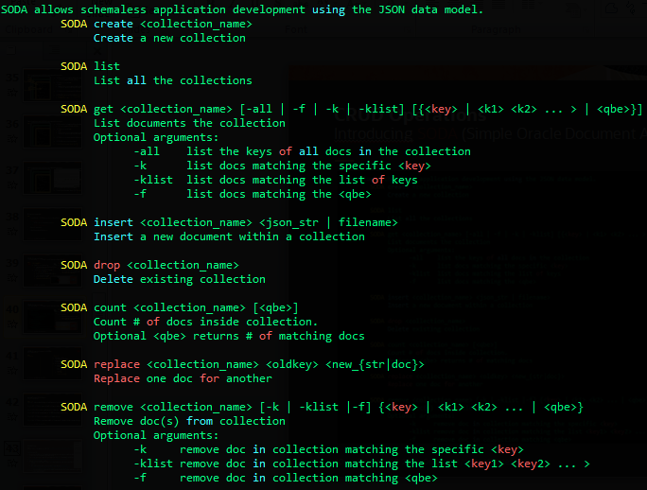
SODA – supported in SQLCL, SQLDeveloperweb
Introducing SODA (Simple Oracle Document Access) and SQLcl
SQLcl
Modern SQL Developer Command Line interface for Oracle database
Provides
inline editing, statement completion, command recall…
SODA commands
(SODA commands also available in SQL Developer Web)

Slide 42
Agenda
Oracle converged Database
JSON in the Database
Autonomous JSON Database
Why Oracle?
Benchmarks
Summary

Slide 43
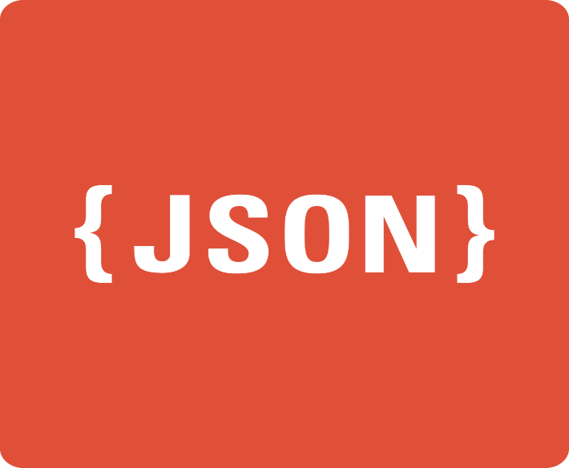
Autonomous JSON Database
A managed cloud service for JSON storage
New ADB-S service for JSON-centric development
Flexible and fast at scale
Native JSON storage
Simple document APIs
Language drivers, command-line, and REST
SQL not required
AJD

Slide 44

Autonomous JSON Database
Provides the same benefits as NoSQL document stores
24
$
7
Elastic compute and storage
Single-digit latency reads and writes
Highly available
Low price, always-free tier

Slide 45









Autonomous JSON Database
More than a simple document store
Autonomous
ACID Transactions
Full SQL query support
APEX low-code development
Advanced security
One-click upgrade to ATP
SQL
REST

Slide 46
New tier between Free ATP and Paid ATP
ATP
ATP functionality with no storage cap
(includes all AJD functionality)
AJD
SODA collections with no storage cap
(includes ATP functionality with 20GB storage cap)
Free ATP
ATP functionality with 20GB storage cap

Slide 47
Autonomous JSON Database: Pricing
Pricing:
$0.2688 OCPU per hour ($200/month)
$0.1591 TB per hour ($118.40/month)
 | Autonomous JSON DB | AWS Document DB | MongoDB Atlas
Configuration | 8 OCPU 1 TB storage | db.r5.4xlarge 16 vCPU (= 8 OCPU) AWS US East (Ohio) | M60 16 vCPU (= 8 OCPU)
Price (on-demand) | $2.30 / hour | $2.35 / hour | $3.95 / hour
Notes:
1 OCPU = 2 vCPU
MongoDB Atlas scenario assumes 300GB only database size
Notes:
https://www.mongodb.com/cloud/atlas/faq
It is free to start with MongoDB Atlas for learning, prototyping, and early development. For dedicated clusters, MongoDB Atlas is billed hourly based on how much you use. The hourly rate depends on a number of factors, most importantly the size and number of servers you use. You will receive a single bill from MongoDB that explains your hourly use and backup fees.
For example, if you deploy on AWS a 3-node replica set of M40s and run it 24/7 for one month using the included 80GB of standard block storage, and you have exactly 80GB, your costs would be:
Per server hourly cost¹: ~$0.34
Total servers: 3
Total hours: 720
Backup data: 80GB @ $2.50/GB/month
Total monthly fees paid to MongoDB: $946.79

Slide 48
Agenda
Oracle converged Database
JSON in the Database
Autonomous JSON Database
Why Oracle?
Benchmarks
Summary

Slide 49
Oracle Database offers JSON and more..
Oracle Database
MongoDB
JSON integrated with breadth of enterprise features
Native support for JSON
Collections API
Full SQL/PLSQL access
Interop with relational
Enterprise grade infrastructure
ACID Transactions, HA, DR, Security
Leverage common infrastructure
for managing all your data
Specialized JSON developer platform
Persist app objects as JSON
Collections API integrated with latest development environments
Automated sharding and replication
This is where MongoDB’s value propositions stop..

Slide 50
Features Support
 |  | Oracle DB | MongoDB
Functionality | Document Collections | ○ | ○
 | Collections API | SODA | Mongo API
 | SQL | ○ | 
 | Stored Procedures, Triggers | ○ | 
 | Schema Discovery, Validation |  | ○
 | Many-many models (Joins, Constraints, Txns) | ○ | 
 | Multimodel (Relational, XML, Full Text, Spatial, ..) | ○ | 
 | Enterprise Security (VPD, TDE, Redaction, ..) | ○ | 
Infrastructure | Sharding, Replication | ○ | ○
 | ACID transactions | ○ | 
 | Engineered Systems optimizations | ○ | 
 | In Memory Columnar store | ○ | 
○ Full support,  No support,  Partial support

Slide 51
Key Differentiators vs MongoDB
1. Interoperability with relational
2. Richer data modeling
3. Transactions, Read consistency
4. Advanced Query engine
5. Hardware optimized
6. Oracle Database platform

Slide 52
1. Interoperability with Relational
SQL/PLSQL access for full interoperability with Relational
JSON generation from relational
JSON_TABLE to extract relational from JSON
JSON natively supported in PL/SQL
Support for both SQL and NoSQL style access
Relational data access requires moving data from relational database to MongoDB
NoSQL style access only with collections API
Oracle Database
MongoDB
Copyright © 1995, 2019, Oracle. All rights reserved. - CONFIDENTIAL

Slide 53
2. Richer Data Modeling
JSON can go up to BLOB limit
Hierarchical and non-hierarchical data modeling
One-many (e.g. dept-courses)
Many-Many (e.g. students-courses)
Many-Many with foreign key-primary key across collections
Constraint enforcement
Full SQL join support
Full transactional consistency
JSON size limited to 16MB
Hierarchical data modeling only
One-many supported well
Many-many is much harder
Many-Many requires normalization similar to relational, but without full infrastructure
Limited joins, constraint
Multi Document transactions added recently but many issues (timeout after 1 minute, older versions in memory only, slower updates)
Oracle Database
MongoDB
Copyright © 1995, 2019, Oracle. All rights reserved. - CONFIDENTIAL

Slide 54


3. Transactions and Consistency
Oracle Database
ACID transactions by default
Transactions across multiple documents and multiple collections
No hand-coding of two-phase commit required
Read consistency by default
Unique multi-version read consistency model ensures that read queries and updates queries run simultaneously, without blocking and with consistent results
Report
Update
update
Update
update
Accurate Results

Slide 55






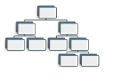








4. Advanced Query Engine
Oracle Database
PROFIT
SQL
SQL
SQL
SQL
SQL
SQL
SQL
SQL
UMSATZ
SALES
SQL
SQL
SQL
SQL
SQL
SQL
SQL
SQL
CAPITAL
SQL
SQL
SQL
SQL
SQL
RENDITO
Comprehensive SQL/JSON Language
Sophisticated query optimization
Joins, aggregations, filters, indexes, query transformations
Smart processing
Parallel, In-memory
Any Answer
Operational, reporting, analytical, predictive
Any data: Structured, Semi-structured

Slide 56
5. Hardware Optimized
Oracle Database
Exadata Smart Scans
Exadata Smart Scans execute portions of SQL queries on Exadata storage cells
JSON query operations ‘pushed down’ to Exadata storage cells
Massively parallel processing of JSON documents
In Memory Columnar Store for JSON
JSON documents loaded into In-Memory Virtual Columns in a highly optimized binary format.
Query operations on JSON content automatically directed to In-Memory or Index by optimizer

Slide 57
6. Oracle Database Platform
Leverage breadth of Oracle Database platform for JSON content
Sharding
RAC
Golden Gate Replication
Flashback
….
Consolidated administration for all mission critical data
Active Data Guard
ZDLRA
Oracle Database
Enterprise Grade Security
Transparent Data Encryption
VPD
Data Masking
Oracle Tools and Utilities
Datapump
SQL*Loader
Apex
SQLDeveloper
Oracle Enterprise Manager

Slide 58
Agenda
Oracle converged Database
JSON in the Database
Autonomous JSON Database
Why Oracle?
Benchmarks
Summary

Slide 59
Single Node Benchmarks
Oracle vs MongoDB

Slide 60
NDA
YCSB Get/Put (5m x 1.3kb docs) - MongoDB Workload with small documents
Methodology: Execute YCSB workloads until maximum
throughput reached. YCSB consists of a set of documents
and the workload inserts, reads, updates a single document
based on a unique id.
Setup: Both client and server on Phoenix Compute.
Oracle DB 19c+ - Oracle DB 19c with format OSON
MongoDB 4.0.10 – with default snappy compression
Source of workload::
https://github.com/brianfrankcooper/YCSB
 | Oracle DB 19c+ | MongoDB 4.0.10
Hardware | Server - VM.DenseIO2.16 (16 cores; Intel(R) Xeon(R) Platinum 8167M CPU @ 2.00GHz; L3 cache: 16MB; RAM: 240MB; 2x 12.8 TB of local NVMe SSD - Phoenix | Same
CPUs | 16 cores | Same
Memory | 120GB | Same
Oracle gmean 1.3x better
(get/put small docs)
Notes:
https://confluence.oraclecorp.com/confluence/display/OLTPP/Document+DB+vs+ATP-S#DocumentDBvsATP-S-Soda(SchemaandClientsideOSONencodingenhancements)

Slide 61
NDA
Customer1 Get/Put (720k x 92kb docs) – MongoDB Workload with large documents
Methodology: Execute Customer1 get/put workloads until
maximum throughput reached.
Setup: Both client and server on Phoenix Compute.
Oracle DB 19c+ - Oracle DB 19c with format OSON
MongoDB 4.0.10 – with default snappy compression
Explanation of performance difference: OSON shows better
Compression for the data in this workload which leads to
Faster gets/puts.
Source of workload::
Customer1 test suite
 | Oracle DB 19c+ | MongoDB 4.0.10
Hardware | Server – Phoenix, VM.DenseIO2.16, 8ocpus | Same
CPUs | 16 cores | Same
Memory | 120GB | Same
Oracle gmean 2.1x better
(get/put large docs)
Notes:
https://confluence.oraclecorp.com/confluence/display/OLTPP/Document+DB+vs+ATP-S#DocumentDBvsATP-S-BofA

Slide 62
NDA
YCSB-JSON Queries, DML (20m x 1kb docs) – MongoDB Out-of-box performance with Primary Key index only
Methodology: 200 clients executing , 240k ops/minute
(36k/min insert, 72k/min update, 36k/min delete,
96k/min read , 12/min EYCSB queries), 1 hour test
Setup:
Oracle DB 19c+ - Oracle DB 19c with format OSON
MongoDB 4.0.9 – with default snappy compression
Explanation of performance difference:
Oracle uses PQ in single node and faster scan over OSON
Source of YCSB-JSON queriess: https://blog.couchbase.com/
ycsb-json-benchmarking-json-databases-by-extending-ycsb
 | Oracle DB 19c+ | MongoDB 4.0.9
Machine | ½ X7 cell (each cell is 2x Xeon Silver 4114 CPU @ 2.20GHz, 10 cores, 2 th/core =40 cpus, 1024k L2, 13M L3, 187Gb RAM) | Same
CPUs | 16 cores | Same
Memory | 115GB | 100 GB
Oracle Query gmean 2.7x better
(no indexes, full table scans)
Notes:
https://confluence.oraclecorp.com/confluence/display/DSPT/JSON+Performance

Slide 63
NDA
YCSB-JSON Queries, DML (20m x 1kb docs) – MongoDB Workload with Secondary Indexes
Methodology: 200 clients executing , 240k ops/minute
(36k/min insert, 72k/min update, 36k/min delete,
96k/min read , 12/min EYCSB queries), 1 hour test
Setup:
Oracle DB 20c+ - Oracle DB 20c with multivalued index
MongoDB 4.0.9 – with default snappy compression
Source of YCSB-JSON queriess: https://blog.couchbase.com/
ycsb-json-benchmarking-json-databases-by-extending-ycsb
 | Oracle DB 19c+ | MongoDB 4.0.9
Machine | ½ X7 cell (each cell is 2x Xeon Silver 4114 CPU @ 2.20GHz, 10 cores, 2 th/core =40 cpus, 1024k L2, 13M L3, 187Gb RAM) | Same
CPUs | 16 cores | Same
Memory | 115GB | 100 GB
Oracle query gmean 3.4x better
With Indexes
Notes:
https://confluence.oraclecorp.com/confluence/pages/viewpage.action?pageId=1402148743#JSONExtendedYCSB:MongovsDocDBvsOracle(ATP-s+OnPrem)-Summary
Search mongo/400

Slide 64
NDA
Customer2 Queries, DML (20m x 1kb docs) – MongoDB Workload with Secondary Indexes
Methodology: 5 secondary indexes for both Oracle,
MongoDB. 200 clients executing 240k ops/minute
(36k/min insert, 72k/min update, 36k/min delete,
96k/min read , 12/min aggregate queries), 1 hour test
Explanation of performance difference:
Oracle queries faster.
DMLs slower because Oracle does full updates in 19c,
Partial updates coming in a future release..
Source of workload::
Customer2 Dataset and queries/DMLs with indexes in place
 | Oracle 19c+ | MongoDB 4.0.9
Machine | ½ X7 cell (each cell is 2x Xeon Silver 4114 CPU @ 2.20GHz, 10 cores, 2 th/core =40 cpus, 1024k L2, 13M L3, 187Gb RAM) | Same
CPUs | 16 cores | Same
Memory | 115GB | 100 GB
Oracle Query gmean 2.2x better
(filter, aggregate)
Notes:
https://confluence.oraclecorp.com/confluence/pages/viewpage.action?pageId=1486240454

Slide 65
Single Node Benchmark
Oracle vs AWS DocumentDB

Slide 66
NDA
YCSB Get/Put (5m x 1.3kb docs) – AWS DocDB Workload with small documents
Methodology: Execute YCSB workloads until maximum
throughput reached. YCSB consists of a set of documents
and the workload inserts, reads, updates a single document
based on a unique id.
Setup:
Oracle ATP-S+ - 19c with OSON enabled
AWS DocDB
Source of workload::
https://github.com/brianfrankcooper/YCSB
 | Oracle ATP-S+ | AWS DocumentDB
Hardware | Ashburn, 8ocpu, 18.4 | Db.r5.4xlarge, 16vcpus, 71GB memory
CPUs | 8 ocpus | 16 vcpus
Memory | 67 GB | 71 GB
Oracle gmean 1.5x better
(get/put small docs)
Notes:
https://confluence.oraclecorp.com/confluence/display/OLTPP/Document+DB+vs+ATP-S#DocumentDBvsATP-S-16vCPUS(8oCPUs)Cloud
** Oracle throughput could be increased by 15% if we
used a 128-bit cipher similar to AWS, instead of 256-bit.

Slide 67
NDA
Customer1 Get/Put (720k x 92kb docs) – AWS DocDB Workload with large documents
Methodology: Execute Customer1 get/put workloads until
maximum throughput reached.
Setup:
Oracle ATP-S+ - 19c with OSON enabled
AWS DocDB
Explanation of performance difference: OSON shows better
compression for the data in this workload which leads to
faster gets/puts.
Source of workload::
Customer1 Dataset
 | Oracle ATP-S+ | AWS DocumentDB
Hardware | Ashburn, 8ocpu | Db.r5.4xlarge, 16vcpus, 71GB memory
CPUs | 8 ocpus | 16 vcpus
Memory | 67 GB | 71 GB
Oracle gmean 2.8x better
(get/put large docs)
Notes:
** Oracle throughput could be increased by 15% if we
used a 128-bit cipher similar to AWS, instead of 256-bit.

Slide 68
NDA
YCSB-JSON Queries, DML (20m x 1kb docs) – AWS DocDB Out-of-box performance with Primary Key index only
Methodology: 200 clients executing , 240k ops/minute
(36k/min insert, 72k/min update, 36k/min delete,
96k/min read , 12/min YCSB-JSON queries), 1 hour test
Setup:
Oracle ATP-S+ - 19c with OSON enabled
AWS DocDB
Explanation of performance difference:
Oracle uses PQ in single node and faster scan over OSON
Source of YCSB-JSON queriess: https://blog.couchbase.com/
ycsb-json-benchmarking-json-databases-by-extending-ycsb
 | Oracle ATP-S+ | AWS DocumentDB
Hardware | Ashburn, 8ocpu, 18.4 | Db.r5.4xlarge, 16vcpus, 71GB memory
CPUs | 8 ocpus | 16 vcpus
Memory | 67 GB | 71 GB
Oracle Query gmean 5x better
(no indexes, full table scans)
Notes:
https://confluence.oraclecorp.com/confluence/pages/viewpage.action?pageId=1402148743#JSONExtendedYCSB:MongovsDocDBvsOracle(ATP-s+OnPrem)-Summary

Slide 69
NDA
YCSB-JSON Queries, DML (20m x 1kb docs) – AWS DocDB Workload with Secondary Indexes
Methodology: 200 clients executing , 240k ops/minute
(36k/min insert, 72k/min update, 36k/min delete,
96k/min read , 12/min YCSB-JSON queries), 1 hour test
Setup:
Oracle ATP-S+ - 19c with OSON enabled
ArrayScan*, ArrayDeepScan* – index support in Oracle
coming soon
ArrayDeepScan* - no index support in, AWS
Source of YCSB-JSON queriess: https://blog.couchbase.com/
ycsb-json-benchmarking-json-databases-by-extending-ycsb
 | Oracle ATP-S+ | AWS DocumentDB
Hardware | Ashburn, 8ocpu, 18.4 | Db.r5.4xlarge, 16vcpus, 71GB memory
CPUs | 8 ocpus | 16 vcpus
Memory | 67 GB | 71 GB
Oracle Query gmean 1.6x better with Indexes
(no Arrayscan, ArrayDeepScan)
Notes:
https://confluence.oraclecorp.com/confluence/pages/viewpage.action?pageId=1402148743#JSONExtendedYCSB:MongovsDocDBvsOracle(ATP-s+OnPrem)-Summary

Slide 70
NDA
Customer2 Queries, DML (20m x 1kb docs) – AWS DocDB Workload with Secondary Indexes
Methodology: 5 secondary indexes for both Oracle,
AWS. 200 clients executing 240k ops/minute
(36k/min insert, 72k/min update, 36k/min delete,
96k/min read , 12/min aggregate queries), 1 hour test
Setup:
Oracle ATP-S+ - 19c with OSON enabled
AWS DocDB
Explanation of performance difference:
Oracle queries faster, especially aggregate query.
Source of workload::
Customer2 Dataset and queries/DMLs with indexes in place
 | Oracle ATP-S+ | AWS DocumentDB
Hardware | Ashburn, 8ocpu | Db.r5.4xlarge, 16vcpus, 71GB memory
CPUs | 8 ocpus | 16 vcpus
Memory | 67 GB | 71 GB
Oracle Query gmean 1.7x better
(filter, aggregate)

Slide 71
Multi Node Benchmarks
Oracle RAC, Exadata

Slide 72
NDA
YCSB Get/Put (5m x 1.3kb docs) – Scale-up with RAC (without enabling node affinity)
Methodology: Execute YCSB workloads until maximum
throughput reached. YCSB consists of a set of documents
and the workload inserts, reads, updates a single document
based on a unique id.
Setup: Run on Exadata X6-2 with 1-4 compute nodes as
Servers configured with RAC, and 1 compute node as client.
* Oracle DB 21c + UCP bug fix
Source of workload::
https://github.com/brianfrankcooper/YCSB
 | Oracle DB 21c
Hardware | Exadata X6-2 EF, Intel(R) Xeon(R) CPU E5-2699 v4 @ 2.20GHz, 88 logical cpus;
Server | 1-4 Compute Nodes with RAC
Client | 1 Compute Node
Memory | L3 cache:- 56320 KB; RAM 256GB
Oracle scales up throughput 2.5x-3.7x with 4 nodes
Notes:
From email dated 7/28/20

Slide 73
NDA
YCSB-JSON Queries, DML (20m x 1kb docs) – Speed up scans with cell offloading on Exadata
Methodology: Single client executing serial queries
doing smart scan offload to Exadata storage cells
Setup:
Oracle DB 19c+ - Oracle DB 19c with format OSON
Explanation of performance difference:
Storage scans execute in parallel on the cells
Source of YCSB-JSON queriess: https://blog.couchbase.com/
ycsb-json-benchmarking-json-databases-by-extending-ycsb/
 | Oracle DB 19c+
Machine | Exadata X6-2 Server – 1 compute node (2x Xeon CPU E5-2699 v4@2.20GHz, 42 cores, 1 th/core =84 cpus, 256k L2, 55M L3, 232Gb RAM), Storage – 14 storage Cells (2x Xeon CPU E5-2630 v4 @2.20GHz, 10 cores, 2 th/core =40 cpus, 256k L2, 25M L3, 125Gb RAM)
Memory | 100 GB
Queries with smart scans gmean 35x better (no indexes, no PQ, no cache, full table scans)
Notes:
https://confluence.oraclecorp.com/confluence/display/DSPT/JSON+Performance

Slide 74
NDA
YCSB-JSON Queries, DML (20m x 1kb docs) – Speed up scans with cell offloading on Exadata
Methodology: Single client executing serial queries
doing smart scan offload to Exadata storage cells
Setup:
Oracle DB 19c+ - Oracle DB 19c with format OSON
Explanation of performance difference:
Storage scans execute in parallel on the cells
Source of YCSB-JSON queriess: https://blog.couchbase.com/
ycsb-json-benchmarking-json-databases-by-extending-ycsb/
 | Oracle DB 19c+
Machine | Exadata X6-2 Server – 1 compute node (2x Xeon CPU E5-2699 v4@2.20GHz, 42 cores, 1 th/core =84 cpus, 256k L2, 55M L3, 232Gb RAM), Storage – 14 storage Cells (2x Xeon CPU E5-2630 v4 @2.20GHz, 10 cores, 2 th/core =40 cpus, 256k L2, 25M L3, 125Gb RAM)
Memory | 100 GB
Queries with smart scans gmean 35x better (no indexes, no PQ, no cache, full table scans)
Notes:
https://confluence.oraclecorp.com/confluence/display/DSPT/JSON+Performance

Slide 75
Agenda
Oracle converged Database
JSON in the Database
Autonomous JSON Database
Why Oracle?
Benchmarks
Summary

Slide 76
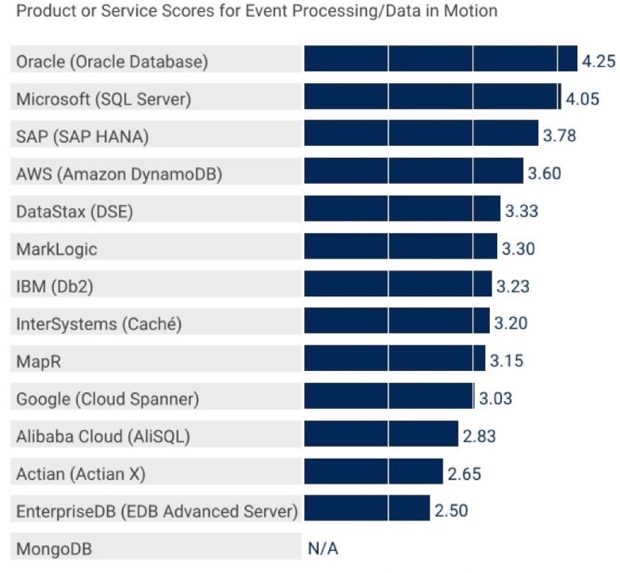
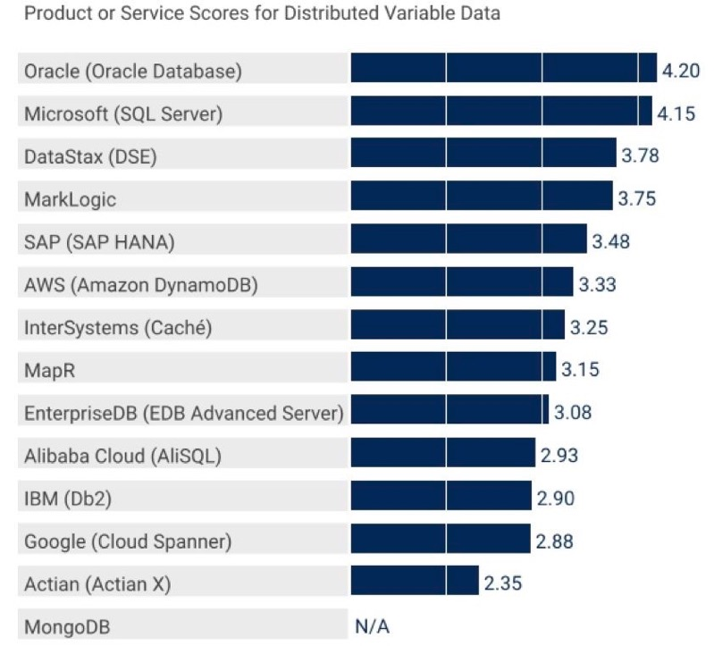
Oracle Scored Highest on All Use Cases in the Gartner Critical Capabilities for Operational Database Management Systems
Ahead of All Single-Purpose Databases and Multi-Purpose Competitors
Gartner Critical Capabilities for Operational Database Management Systems Donald Feinberg, Merv Adrian and Nick Heudecker, October 23, 2018
These graphics were published by Gartner Inc. as part of a larger research document and should be evaluated in the context of the entire document. The Gartner document is available upon request from Oracle. Gartner does not endorse any vendor, product or service depicted in its research publications, and does not advise technology users to select only those vendors with the highest ratings of other designation. Gartner research publications consist of the opinions of Gartner’s research organization and should not be construed as statements
of fact. Gartner disclaims all warranties, expressed or implied, with respect to this research, including any warranties of merchantability or fitness for a particular purpose.

Slide 77
JSON Features included (free) in all editions of Oracle Database on-premises and cloud
Oracle Database on-prem
Releases 12cR1, 12cR2, 18c, 19c
all editions: XE, SE, EE
Oracle Database as a Service
Provision a full Database Instance
Includes all JSON capabilities
Advanced Database Features
In Memory Columnar, Partitioning, Exadata
Oracle Autonomous Database
(ATP, ADW, Free Service)
All JSON features available
Trying out..
Autonomous Database Free service
18c XE released in Oct 2018
Docker images available on github
https://github.com/oracle/docker-images/tree/master/OracleDatabase

Slide 78
Summary – Oracle Database JSON Document Database
Modern document-centric development
JSON Collections-based data model (only)
Rich clients - REST and SODA based development API
Server-side in-database Javascript procedures
... proven enterprise database features to accelerate development
ACID Transactions with Sharding
SQL-based Reporting and Analytics
Parallel Execution
... running on an Autonomous enterprise platform
Availability
Security
Elasticity

Slide 79
Learn more..
Oracle.com
Oracle JSON Database - https://www.oracle.com/database/technologies/appdev/json.html
Documentation
JSON Developer Guide - https://docs.oracle.com/en/database/oracle/oracle-database/19/adjsn/index.html
SODA Documentation - https://docs.oracle.com/en/database/oracle/simple-oracle-document-access/index.html
Github
SODA for Java - https://github.com/oracle/soda-for-java
SODA for node.js - https://github.com/oracle/node-oracledb
SODA for python - https://github.com/oracle/python-cx_Oracle
bch_t
Wine Demo - https://github.com/oracle/json-in-db/tree/master/WineDemo
MuShop Demo - https://github.com/oracle-quickstart/oci-cloudnative/tree/master/src/carts
Twitter

Slide 80
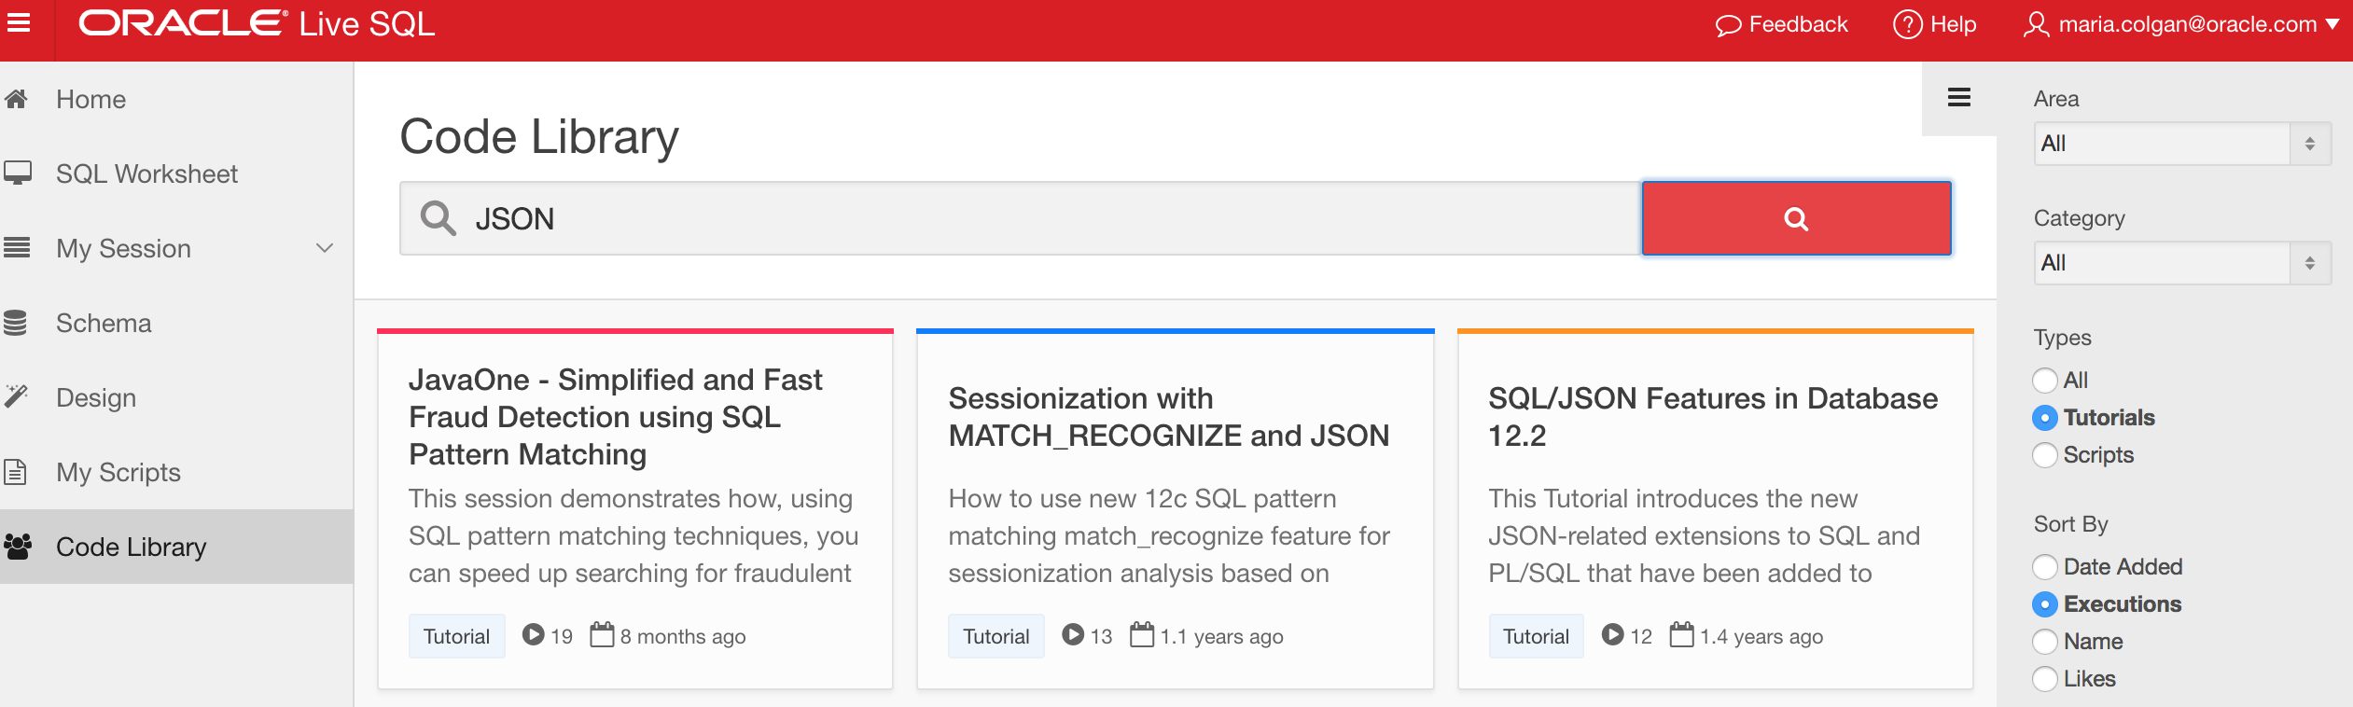
JSON tutorial on LiveSQL
livesql.oracle.com

